Slide 1

DATABASE MANAGEMENT SYSTEM
Employee Leave Management System
A complete SQL database solution featuring automated leave tracking, manager approvals, audit log triggers, and analytical reporting.
TECHNOLOGY
PRESENTED BY
MySQL & MySQL Workbench
G. Rajasree

Slide 2
CHALLENGES & ISSUES
Problem Statement
Manual Administrative Overhead
Lack of Real-Time Quota Tracking
Traditional paper forms and emails cause significant operational delays and data inconsistencies.
Absence of automated balance calculation makes tracking remaining leave days difficult for staff.
No Auditability & History
Complex Organizational Reporting
Manual approval processes leave organizations without reliable historical audit trails for status updates.
Gathering department-wide analytics or employee statistics requires tedious manual data compilation.

Slide 3
GOALS & SCOPE
Project Objectives
Centralized Relational Schema
Automated Audit Logging
Structure data across normalized related tables with strict relational integrity constraints.
Utilize database triggers to track all request submissions and status modifications automatically.
Safe Transactional Workflows
Comprehensive SQL Analytics
Implement TCL operations and procedures for error-free atomic leave balance updates.
Enable data-driven insights through complex joins, views, and aggregate queries.

Slide 4
DATABASE DESIGN
Schema Architecture
Normalized relational structure across key system entities
Table Name | Primary Key | Foreign Keys & Key Attributes | Description
Departments | department_id | department_name | Stores department metadata
Employees | employee_id | department_id (FK), phone, email | Employee profiles and contact details
Managers | manager_id | manager_name | Approval manager records
Leave_Types | leave_type_id | leave_type_name | Leave categories (Sick, Casual, etc.)
Leave_Requests | leave_id | employee_id, manager_id, leave_type_id | Main transactional leave applications
Leave_Balance | employee_id | remaining_days | Tracks remaining available leave days
Leave_Status_History | history_id | leave_id, old_status, new_status | Automated status update audit trail

Slide 5
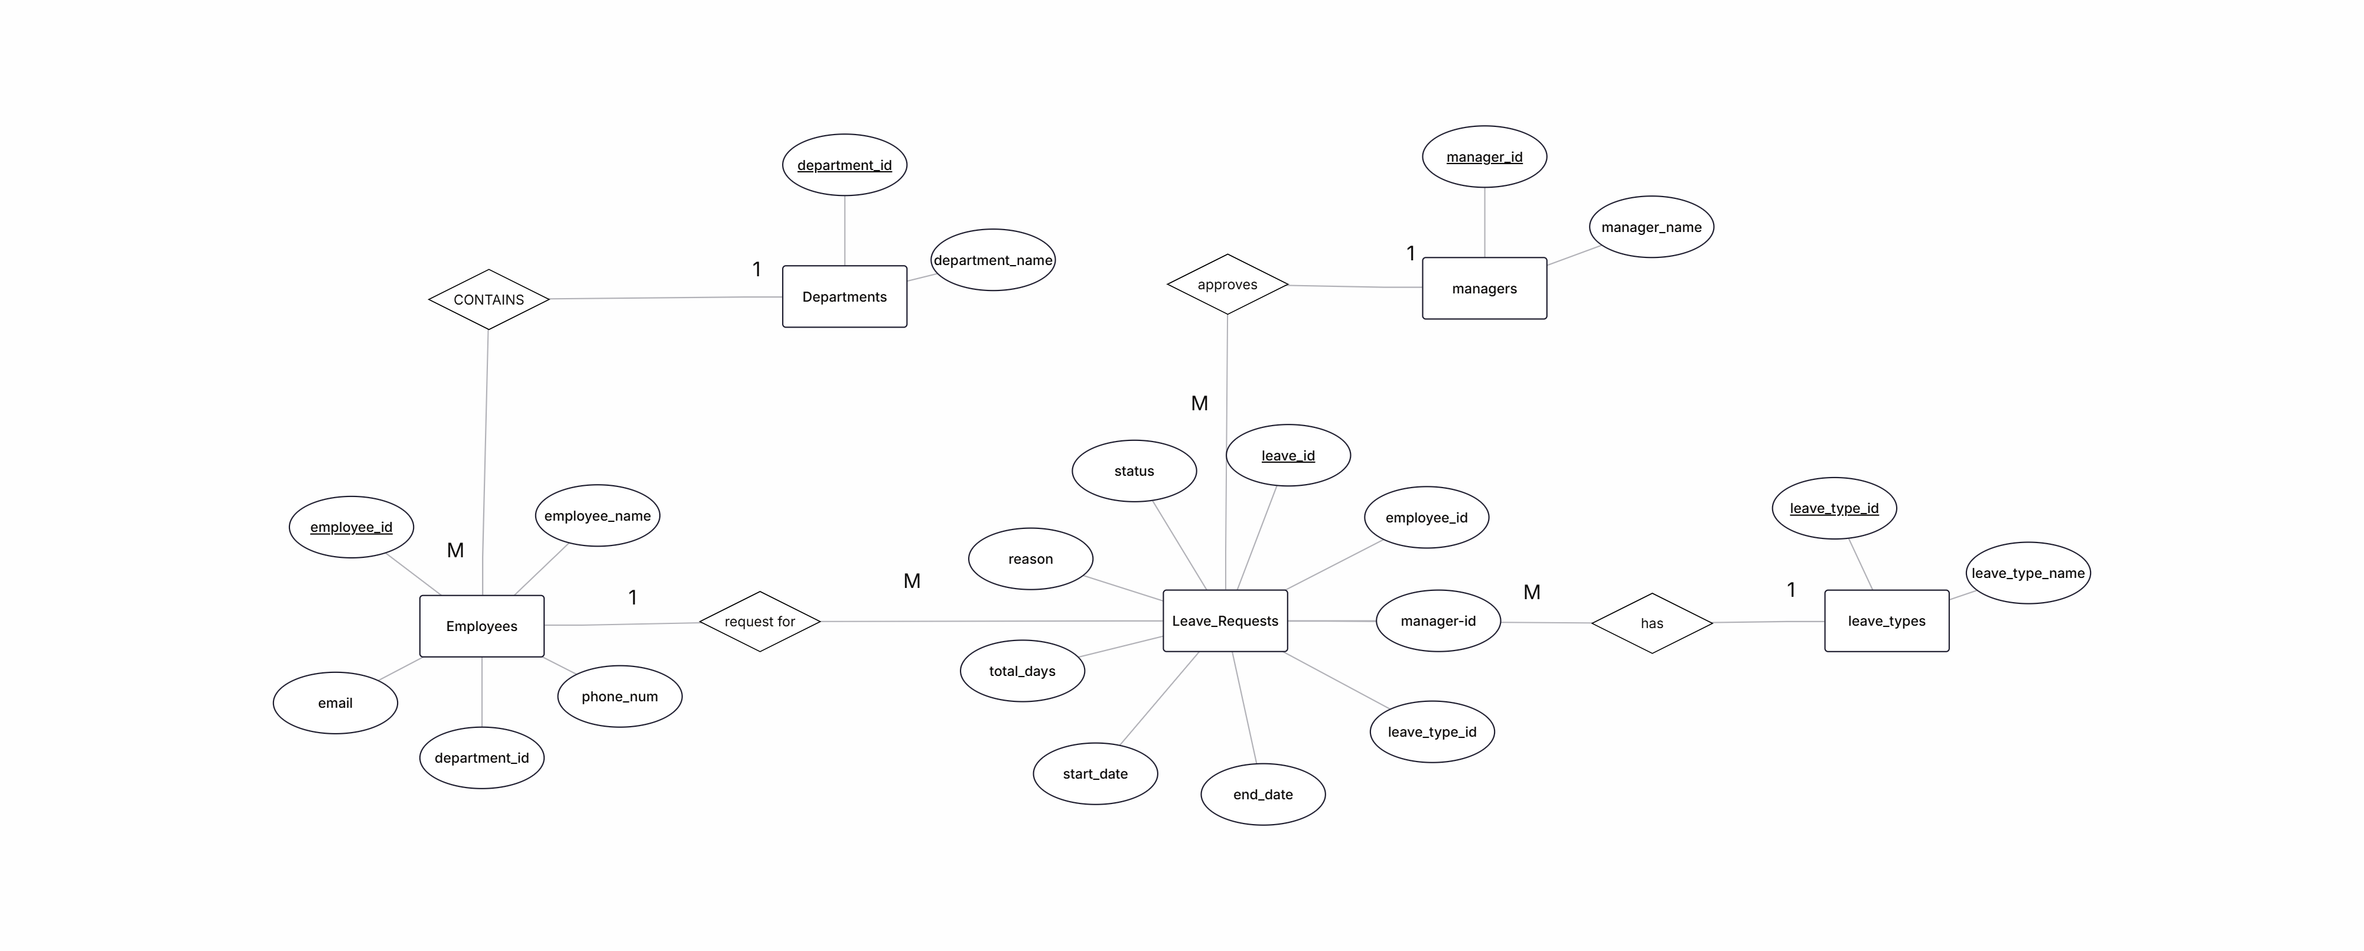

VISUAL SCHEMA MODEL
Entity-Relationship (ER) Diagram
[ Insert / Paste ER Diagram Screenshot Here ]
Visualizes foreign key relationships between Departments, Employees, Managers, Leave Types, and Leave Requests tables.

Slide 6
SQL SUMMARY OPERATIONS
Aggregate Functions (COUNT, SUM, AVG)
Definition: Aggregate functions compute a single summary result value from a set of input values (e.g., COUNT, SUM, AVG, MAX, MIN).
SELECT D.department_name, COUNT(L.leave_id) AS total_requests FROM Departments D LEFT JOIN Employees E ON D.department_id = E.department_id LEFT JOIN Leave_Requests L ON E.employee_id = L.employee_id GROUP BY D.department_id, D.department_name;
QUERY OUTPUT TABLE
department_name | total_requests
HR / IT / Finance / Sales | 2 (Each)
Administration | 2

Slide 7
TEXT MANIPULATION
String Functions (UPPER, LOWER, CONCAT)
Definition: String functions manipulate and format text string data such as changing case or concatenating values.
SELECT employee_name, UPPER(employee_name) AS uppercase_name, LOWER(employee_name) AS lowercase_name, CONCAT('EL-', employee_id) AS leave_reference FROM Employees LIMIT 3;
QUERY OUTPUT TABLE
employee_name | uppercase | lowercase | leave_ref
Aarav | AARAV | aarav | EL-101
Bhavya | BHAVYA | bhavya | EL-102
Charan | CHARAN | charan | EL-103

Slide 8
TEMPORAL CALCULATIONS
Date Functions (DATEDIFF)
Definition: Date functions evaluate, calculate, and format temporal date and time values or date intervals.
SELECT leave_id, employee_id, start_date, end_date, DATEDIFF(end_date, start_date) + 1 AS leave_duration FROM Leave_Requests LIMIT 3;
QUERY OUTPUT TABLE
leave_id | emp_id | start_date | end_date | duration
1001 | 101 | 2026-07-01 | 2026-07-03 | 3 Days
1002 | 102 | 2026-07-02 | 2026-07-04 | 3 Days
1003 | 103 | 2026-07-05 | 2026-07-06 | 2 Days

Slide 9
MULTI-TABLE COMBINATION
SQL Joins (JOIN / INNER JOIN)
Definition: JOIN clauses combine rows from two or more tables based on a related column between them.
SELECT L.leave_id, E.employee_name, L.start_date, L.end_date, L.status FROM Leave_Requests L JOIN Employees E ON L.employee_id = E.employee_id;
QUERY OUTPUT TABLE
leave_id | employee_name | start_date | status
1001 | Aarav | 2026-07-01
1002 | Bhavya | 2026-07-02
1003 | Charan | 2026-07-05
APPROVED
PENDING
APPROVED

Slide 10
NESTED QUERY LOGIC
Subqueries
Definition: A Subquery is a query nested inside another query statement to return data used in the main query logic.
SELECT E.employee_name, L.total_days FROM Employees E JOIN Leave_Requests L ON E.employee_id = L.employee_id WHERE L.total_days >
( SELECT AVG(total_days) FROM Leave_Requests );
QUERY OUTPUT TABLE
employee_name | total_days | Comparison
Aarav | 3 Days | > Avg (2.5d)
Bhavya | 3 Days | > Avg (2.5d)
Hari | 5 Days | > Avg (2.5d)

Slide 11
VIRTUAL TABLES
Database Views (CREATE VIEW)
Definition: A View is a virtual table based on the result-set of an SQL statement for reusable and secure access.
CREATE OR REPLACE VIEW Pending_Leaves AS SELECT L.leave_id, E.employee_name, L.start_date, L.total_days, L.status FROM Leave_Requests L JOIN Employees E ON L.employee_id = E.employee_id WHERE L.status = 'Pending';
PENDING_LEAVES VIEW OUTPUT
leave_id | employee_name | start_date | status
1002 | Bhavya | 2026-07-02
1006 | Farhan | 2026-07-11
PENDING
PENDING

Slide 12
TRANSACTION MANAGEMENT
Transaction Control Language (TCL)
Definition: TCL commands manage transactions within the database to maintain consistency and atomic execution.
START TRANSACTION; UPDATE Leave_Requests SET status = 'Cancelled' WHERE leave_id = 1001; UPDATE Leave_Balance SET remaining_days = remaining_days + 3 WHERE employee_id = 101; COMMIT;
TRANSACTION EXECUTION TABLE
Step | Command | Result
Step 1 | START TRANSACTION | Initiated
Step 2 | UPDATE Leave_Requests | Status Cancelled
Step 3 | UPDATE Leave_Balance | Balance +3 Days
Step 4 | COMMIT | Committed

Slide 13
REUSABLE LOGIC
Stored Procedures
Definition: A Stored Procedure is a prepared SQL code snippet saved on the database server that can be re-executed using parameters.
CREATE PROCEDURE GetManagerLeaves(IN p_manager_id INT) BEGIN SELECT E.employee_name, L.leave_id, L.status FROM Leave_Requests L JOIN Employees E ON L.employee_id = E.employee_id WHERE L.manager_id = p_manager_id; END; CALL GetManagerLeaves(1);
CALL OUTPUT (MANAGER ID = 1)
employee_name | leave_id | status
Aarav | 1001
Gopi | 1007
APPROVED
APPROVED

Slide 14
AUTOMATED EVENT AUDITING
Database Triggers
Definition: A Trigger automatically fires and executes an SQL block when an INSERT, UPDATE, or DELETE operation occurs.
CREATE TRIGGER trg_leave_status_history AFTER UPDATE ON Leave_Requests FOR EACH ROW BEGIN IF OLD.status <> NEW.status THEN INSERT INTO Leave_Status_History(leave_id, employee_id, old_status, new_status) VALUES (NEW.leave_id, NEW.employee_id, OLD.status, NEW.status);
END IF;
END;
TRIGGER OUTPUT TABLE (AUDIT HISTORY LOG)
leave_id | emp_id | old_status | new_status
1001 | 101
1002 | 102
PENDING
APPROVED
CANCELLED
PENDING

Slide 15




SYSTEM ENVIRONMENT
Tech Stack & Architecture
Database Engine
Management Interface
Query Languages
Server-Side Logic
MySQL 8.0 Server providing high-performance storage.
MySQL Workbench for visual modeling & ER design.
SQL covering DDL, DML, DQL, and TCL command suites.
MySQL Triggers, Stored Procedures, and Views.

Slide 16


THANK YOU!
The Employee Leave Management System database project presentation is complete.
Questions & Discussion

